Slide 1
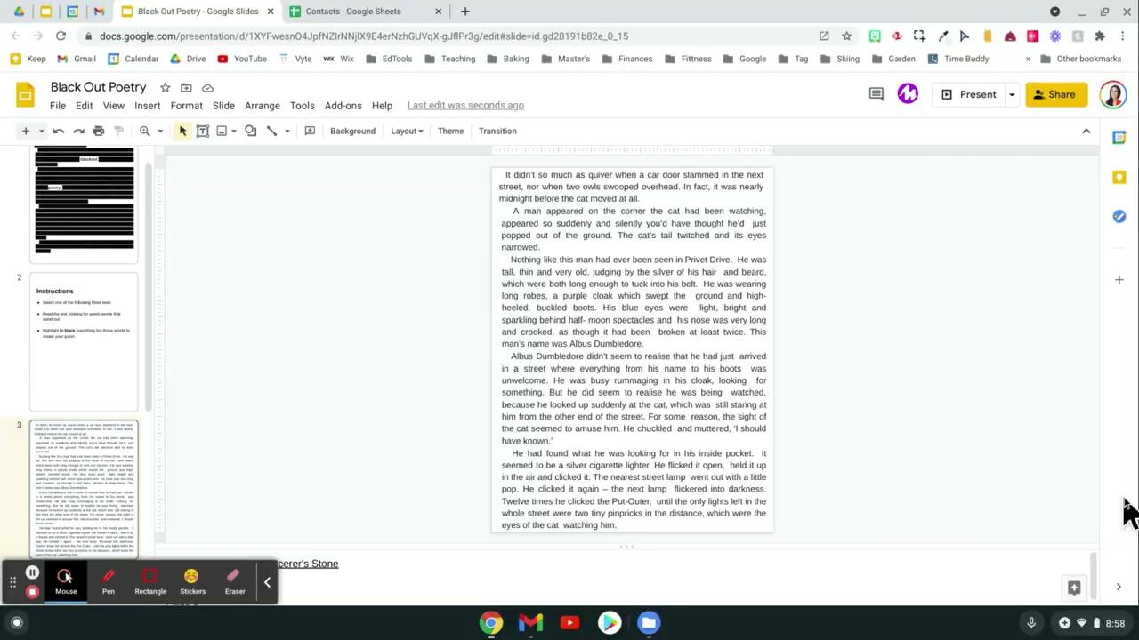
Instructions
Select one of the provided three slides/texts
Read the text, looking for poetic words that stand out
Highlight in black everything EXCEPT those words to create your poem
Watch for Demo

Slide 2
It didn’t so much as quiver when a car door slammed in the next street, nor HALLOWEEN owls swooped overhead. In fact, it was nearly midnight before the cat moved at all.
A man appeared on the corner the cat had been watching, appeared so suddenly and silently you’d have thought he’d just popped out of the ground. The blackout cat’s tail twitched and its eyes narrowed.
Nothing like this man had ever been seen in Privet Drive. He was tall, thin and very old, judging by the silver of his hair and beard, which were both long enough to tuck into his belt. He was wearing long robes, a purple cloak which swept the ground and high- heeled, poetry boots. His blue eyes were light, bright and sparkling behind half- moon spectacles and his nose was very long and crooked, as though it had been broken at least twice. This man’s name was Albus Dumbledore.
Albus Dumbledore didn’t seem to realise that he had just arrived in a street where everything from his name to his boots was unwelcome. He was busy rummaging in his cloak, looking for something. But he did to realise he was being watched, because he looked up suddenly at the cat, which was still staring at him from the other end of the street. For some reason, the sight of the cat seemed to amuse him. He chuckled and muttered, ‘I should have known.’
He had found what he was looking for in his inside pocket. It seemed to be a silver cigarette lighter. He flicked it open, held it up in the air a

